Slide 1
Ancient Egypt
Element: Describe the developments of Egyptian societies including the religious, cultural, economic, and political facets of society.
Vocabulary: Ancient Egypt, pharaoh, pyramid, theocracy, mummification, dynasty, papyrus-will be done as a class.

Slide 3
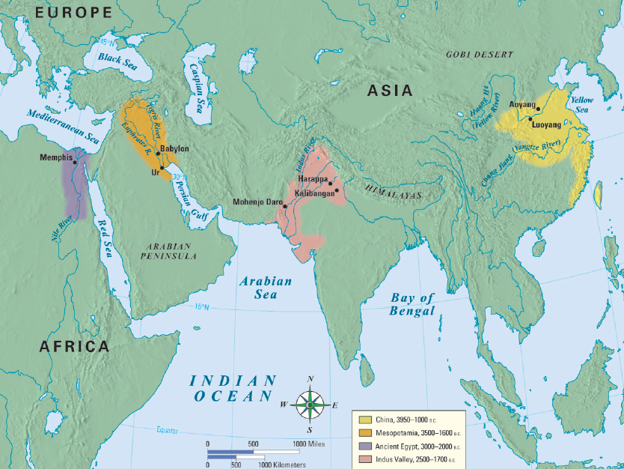
Ancient Egypt
Notes:
3

Slide 4
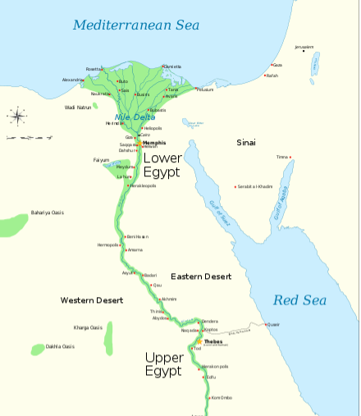

Slide 5
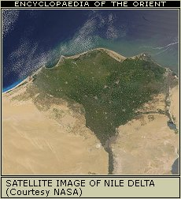
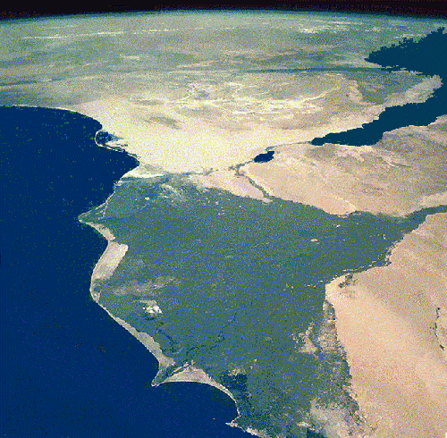
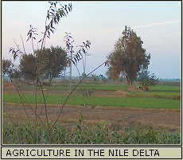
Geography

Slide 6
https://www.youtube.com/watch?v=hO1tzmi1V5g

Slide 7
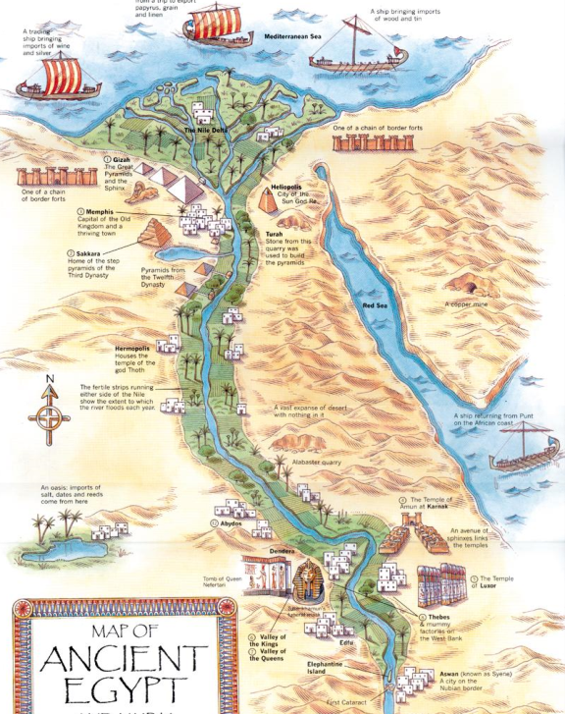
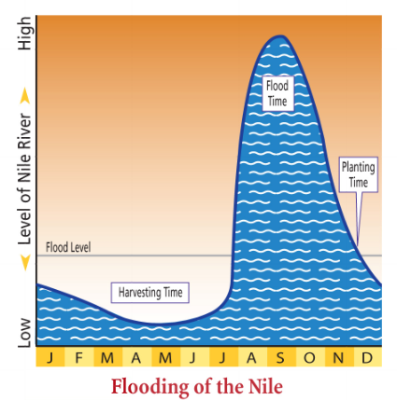
Egypt began along the Nile River in North Africa
Egypt was bordered on both sides by desert which isolated & protected Egyptians from outsiders
The Nile River’s annual floods were predictable & provided fertile soil for farming
The Nile flooded so predictably that the Egyptians designed their calendar around it
Notes:
The Geography of Egypt
From the highlands of East Africa to the Mediterranean Sea, the Nile River flows northward across Africa for over 4,100 miles, making it the longest river in the world. A thin ribbon of water in a parched desert land, the great river brings its water to Egypt from distant mountains, plateaus, and lakes in present-day Burundi, Tanzania, Uganda, and Ethiopia. Egypt’s settlements arose along the Nile on a narrow strip of land made fertile by the river. The change from fertile soil to desert—from the Black Land to the Red Land—was so abrupt that a person could stand with one foot in each.
The Gift of the Nile As in Mesopotamia, yearly flooding brought the water and rich soil that allowed settlements to grow. Every year in July, rains and melting snow from the mountains of east Africa caused the Nile River to rise and spill over its banks. When the river receded in October, it left behind a rich deposit of fertile black mud called silt. Before the scorching sun could dry out the soil, the peasants would prepare their wheat and barley fields. All fall and winter they watered their crops from a network of irrigation ditches. In an otherwise parched land, the abundance brought by the Nile was so great that the Egyptians worshiped it as a god who gave life and seldom turned against them. As the ancient Greek historian Herodotus remarked in the fifth century B.C., Egypt was the “gift of the Nile.”
7

Slide 8
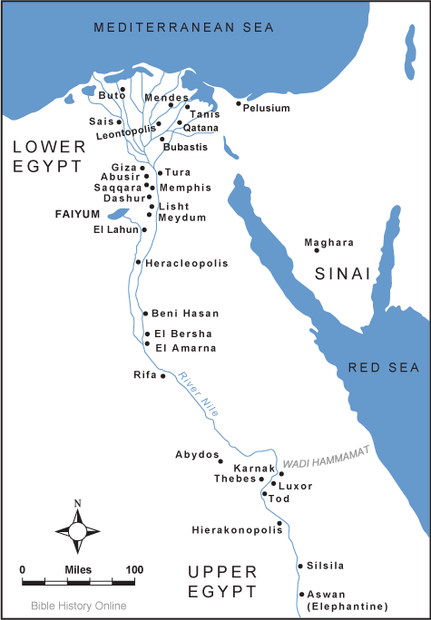
Lasting Contributions
Advanced Cities:
Cities developed along the Nile River in “Upper Egypt” & “Lower Egypt”
Notes:
8

Slide 9
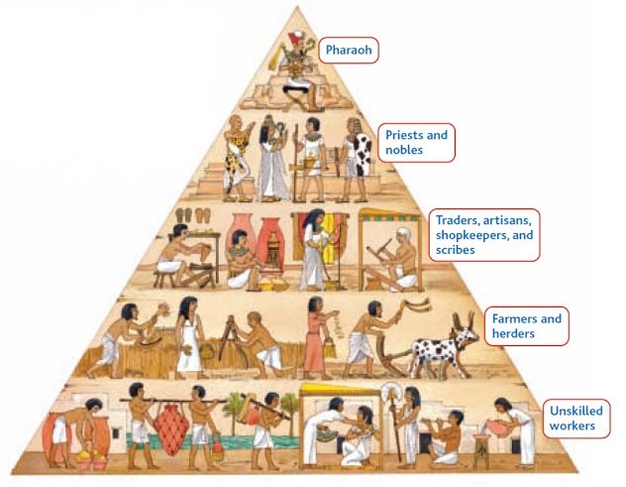
Lasting Contributions
Specialized Workers:
?
Notes:
9

Slide 10
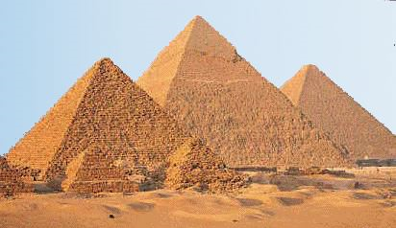
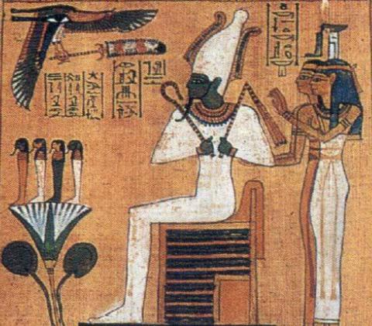
Lasting Contributions
Government :
Pharaohs ruled Egypt as “king-gods” & were thought to control nature
Egyptians constructed pyramids & elaborate tombs for the pharoahs
Notes:
10

Slide 11
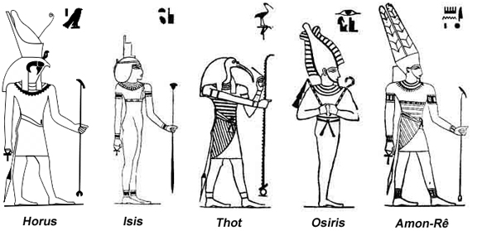
Lasting Contributions
Religion:
Egyptians were polytheistic & believed the gods controlled all aspects of life
Notes:
11

Slide 12
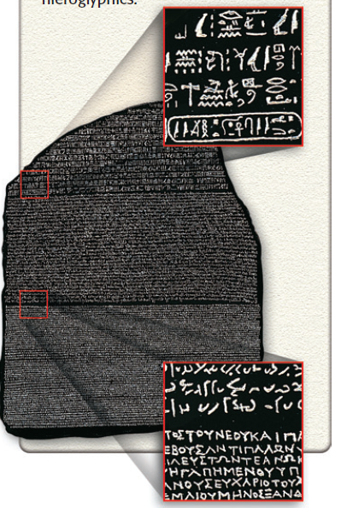
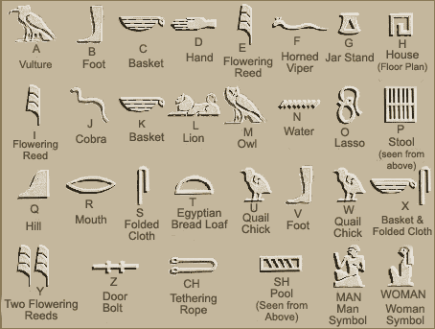
Lasting Contributions
Writing:
Egyptian hieroglyphics was both pictograms & a phonetic alphabet
Hieroglyphics were translated using the Rosetta Stone
Notes:
12

Slide 13
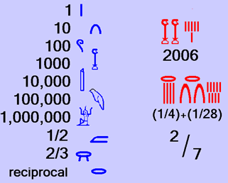
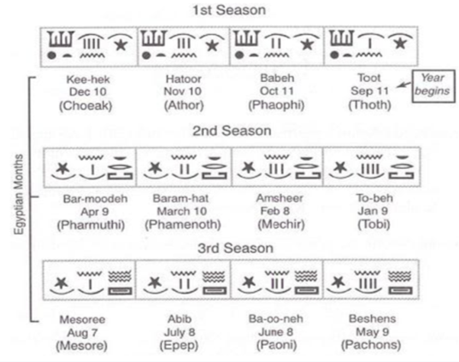
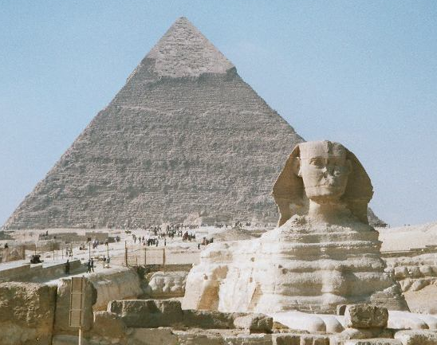
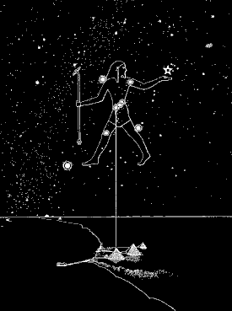
Lasting Contributions
Technology:
Egyptian ideas included a 365-day calendar, geometry, astronomy, & pyramids
Notes:
13

Slide 14
Geography
“The Gift of the Nile”
Nile is the longest river in the world
Lower Egypt or the Nile delta = the area where the Nile splits in two, before it empties into the Mediterranean
Upper Egypt = the land upstream
Winds helped ships travel north=more trade
Deserts created barriers for defense

Slide 15
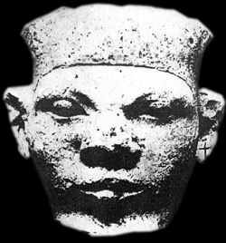
Egypt Unified
began around 3100 B.C.
King Menes united Upper and Lower Egypt
created the first dynasty in Egypt
dynasty = a family of rulers whose right to rule is passed on within the family

Slide 17
Ancient Egypt
Separated into 3 political periods
Old Kingdom
Middle Kingdom
New Kingdom

Slide 18
The Old Kingdom
2700–2200 B.C.
rulers became known as pharaohs
the political and religious leader of the people
thought to be a god-king
Theocracy based on Pharaoh worship
appointed governors to do daily jobs
collected taxes

Slide 19
The Old Kingdom
began to build pyramids
began practicing mummification
began using papyrus and hieroglyphics for record keeping and telling stories

Slide 20
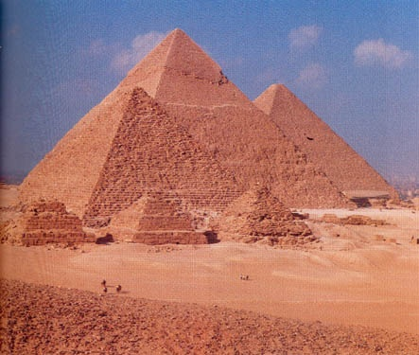
The Great Pyramid

Slide 21
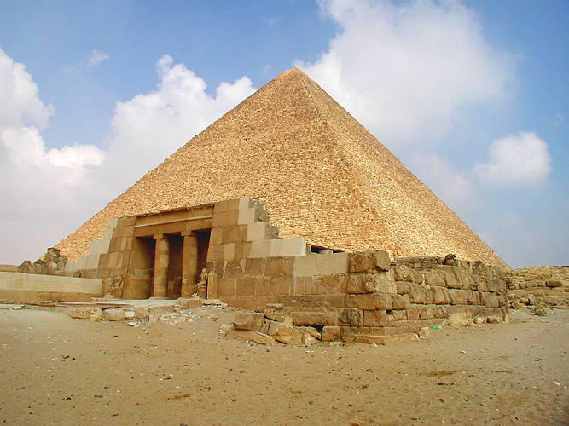
The Great Pyramid

Slide 22
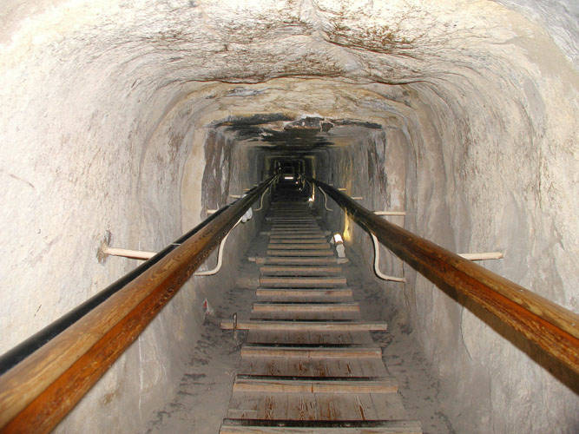
The Great Pyramid

Slide 23
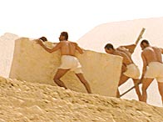
The Great Pyramid
The Pyramids were considered "Houses of Eternity“.
Tallest human-made structure until the Eiffel Tower in the 1800's
Took approximately 23 years to build
All pyramids had to have a North-facing entrance, to align with the North Star.
Built by farmers and other laborers during the Inundation (flood season)
Most stones weigh 2.5 tons, but some weigh up to 80 tons
Laborers used mud-slicked ramps to move the stones.
Notes:
A 7 wonder of the world

Slide 24
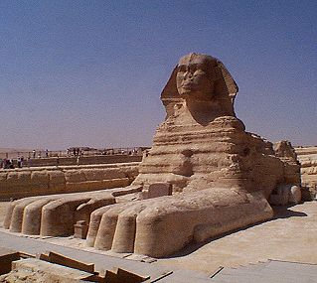
The Great Pyramids
The Sphinx stands before the Pyramid of Pharaoh Khafre.
The Sphinx was carved from a single block of limestone left over in the quarry used to build the Pyramids.
The Sphinx is said to represent the body of a lion and the head of a pharaoh.
Notes:
Calf-re

Slide 25
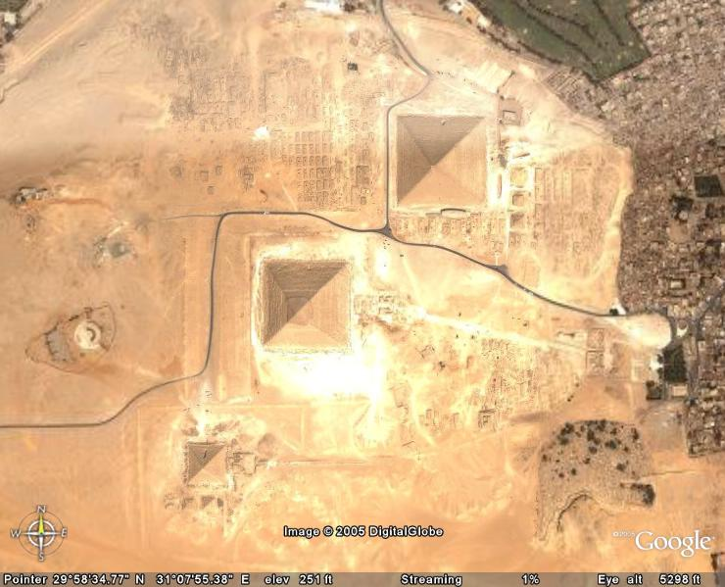
The Great Pyramids

Slide 26
The Rosetta Stone
A stone tablet found by French soldiers of Napoleon’s army. It is the key to translating Egyptian Hieroglyphics.

Slide 27
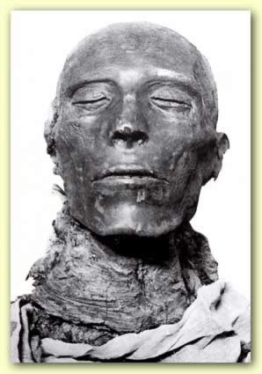
Mummification
https://www.khanacademy.org/humanities/ancient-art-civilizations/egypt-art/ptolemaic/v/the-mummification-process
Notes:
The economy began to be strained by huge government building projects.
People became unhappy with the pharaoh's demands for taxes to pay for these projects.
Pharaoh Pepy III ruled for 92 years, he eventually lost control over the central government - local governors took over.
This period without any pharaohs lasted about 150 years - there were foreign invasions and disorder during this time.

Slide 28
The Middle Kingdom
2180 BCE invaders end the Old Kingdom
2050–1652 B.C.
golden age of stability
pharaohs displayed a new concern for the people
undertook public works such as draining swampland to provide more farming land
Egyptian trade increased with Western Asia, creating a new wealthy class of "common people" - Middle Class
the Hyksos invaded from western Asia
the Hyksos were "hill-people" from Western Asia, who invaded and took over Lower Egypt for 150 years.
had horse-drawn chariots and superior bronze weapons
Notes:
Hick-sos

Slide 30
The New Kingdom
1567-1085 B.C.
Hyksos driven out
a militaristic and powerful state which becomes an Empire
trade with other countries enhances wealth and prestige
Notes:
Egypt’s economy now included goods from other lands.
Expansion & Trade
Lebanon & Syria: silver, timber, wine
Greece (across the Mediterranean): olive oil
Nubia gave access to other African kingdoms, traded ebony, leopard skins, and elephant ivory. Egypt also gained gold, copper, and other precious stones.

Slide 31
The Pharaohs of the New Kingdom
Hatshepsut-1st female Pharaoh
Expanded trade farther than any other Pharaoh.
Over-thrown by her stepson who tried to wipe her name from existence.
Akhenaton & Nefertiti
tried to make Egypt worship only one god - Aton (monotheistic)
destroyed all images of old gods
when Akhenaton died, the old religion returned and the priests picked a new pharaoh that they could control - a boy king.
His name was...

Slide 32
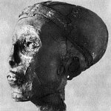
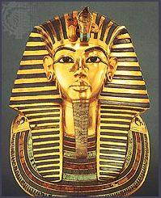
King Tutankhamen
The Boy Pharaoh
King Tutankhamen was 9 years old when he was chosen to replace Akhenaton.
The priests of Egypt controlled King Tut, who died when he was only 19 years old.
King Tut probably died from a broken leg, scientists say, possibly closing one of history's most famous cold cases. A CT scan of King Tutankhamun's mummy has disproved a popular theory that the Egyptian pharaoh was murdered by a blow to the head more than 3,300 years ago-https://news.nationalgeographic.com/news/2006/12/king-tut-died-from-broken-leg--not-murder--scientists-conclude/

Slide 33
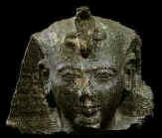
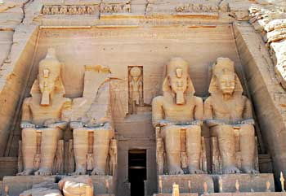
King Rameses II
Took over after King Tut.
His fiercest enemy was the Hittites
Rameses II, a very strong pharaoh, made peace with the Hittites for 67 years and returned some prosperity to Egypt.
In 525 BC the Persian army invaded and conquered Ancient Egypt - it never regained its previous glory

Slide 34
Society
organized like a pyramid
pharaoh at the top
surrounded by a ruling class of nobles and priests who ran the government and managed their own estates
below the upper class were merchants, artisans, scribes, and tax collectors
largest number of people was peasants who worked the land, paid taxes, and provided military service and labor

Slide 36
Advancements
Pyramids, temples, and other monuments exemplify the architectural and artistic achievements
advances in geometry, able to calculate area and volume
hieroglyphics, or ‘sacred carvings’
practice of medicine
Notes:
Egyptian men and women wore makeup. It was thought to have healing powers, plus it helped protect their skin from the sun.
They used moldy bread to help with infections.
They were one of the first civilizations to invent writing. They also used ink to write and paper called papyrus.
The Ancient Egyptians were scientists and mathematicians. They had numerous inventions including ways to build buildings, medicine, cosmetics, the calendar, the plow for farming, musical instruments, and even toothpaste.
Ancient Egypt plays a major role in the Bible. The Israelites were held captive there as slaves for many years. Moses helped them escape and led them to the Promised Land.
The Pharaoh kept his hair covered. It was not to be seen by regular people.
Cats were considered sacred in Ancient Egypt.

