Slide 1
Ancient Asian Civilizations

Slide 2
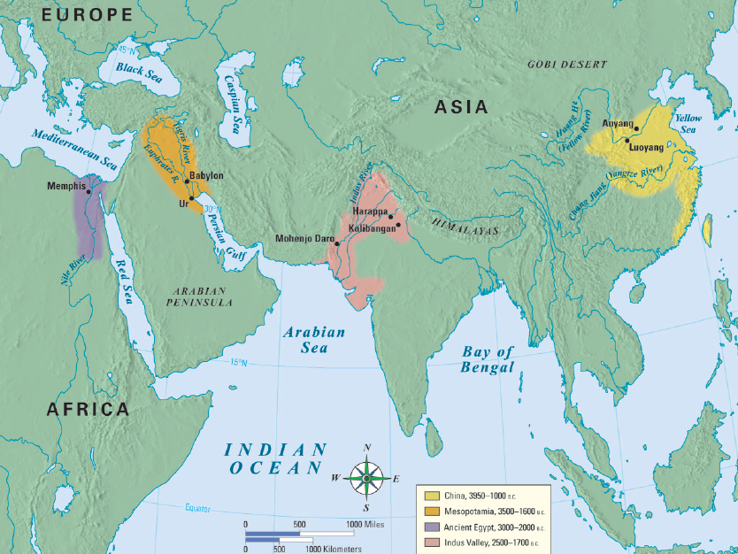
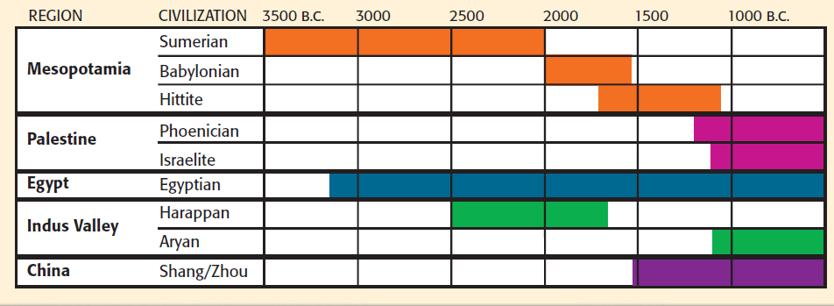
The Indus River Valley (India)
Notes:
2

Slide 3
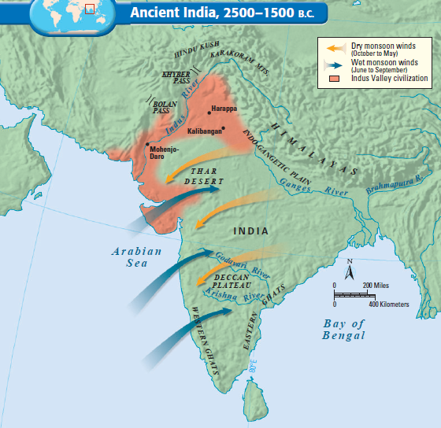
India began along the Indus River, which flooded & left behind fertile soil
Seasonal monsoons caused summer rains & floods
The people were well protected on the Indian “subcontinent” by the oceans, mountains, & deserts that surrounded the Indus River Valley
Notes:
3

Slide 4
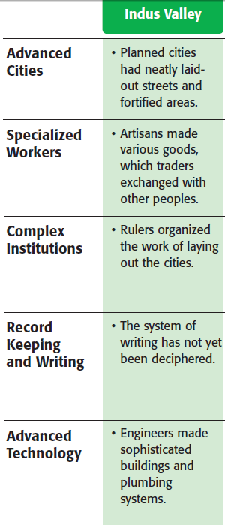
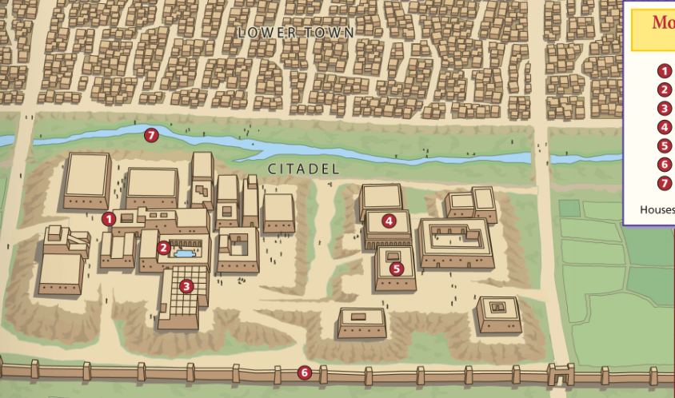
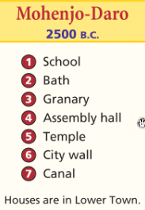
Lasting Contributions
Advanced cities:
Indus cities were laid out in a grid system with high walls & citadel of major buildings
Notes:
One of the most remarkable achievements of the Indus Valley people was their sophisticated city planning. The people of the Indus laid out their cities on a precise grid system. Cities featured a fortified area called a citadel, which contained the major buildings of the city. Buildings were constructed of oven-baked bricks cut in standard sizes, unlike the irregular mud bricks of the Mesopotamians. Early engineers also created sophisticated plumbing, sewage, and bath systems.
4

Slide 5
Lasting Contributions
Specialized Workers:
Indian society was divided by the “caste system” which divided people based on their purity in Hinduism
Notes:
5

Slide 6
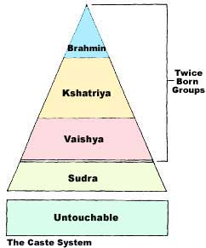

Slide 7
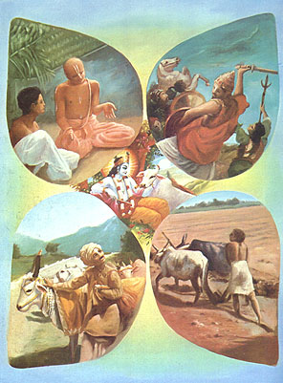
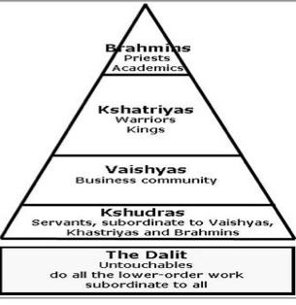

Slide 8
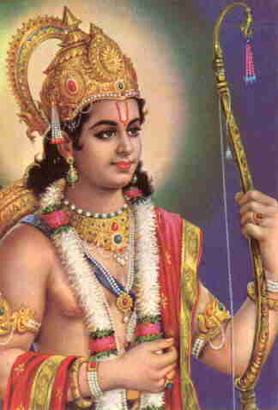
Lasting Contributions
Government:
Little is known about Indus government other than they were ruled by kings
Notes:
8

Slide 9
Lasting Contributions
Religion:
Believed in a polytheistic religion called Hinduism
Hindus believe that one’s soul is reborn until moksha is achieved (reincarnation)
Moksha (enlightenment or nirvana) is the spiritual release from human form
A soul’s karma (good or bad deeds) effect reincarnation
Notes:
The Upanishads are written as dialogues, or discussions, between a student and a teacher. In the course of the dialogues, the two explore how a person can achieve liberation from desires and suffering. This is described as moksha (MOHK•shah), a state of perfect understanding of all things. The teacher distinguishes between atman, the individual soul of a living being, and Brahman, the world soul that contains and unites all atmans.
When a person understands the relationship between atman and Brahman, that person achieves perfect understanding (moksha) and a release from life in this world. This understanding does not usually come in one lifetime. By the process of reincarnation (rebirth), an individual soul or spirit is born again and again until moksha is achieved. A soul’s karma—good or bad deeds—follows from one reincarnation to another. Karma influences specific life circumstances, such as the caste one is born into, one’s state of health, wealth or poverty, and so on.
9

Slide 10
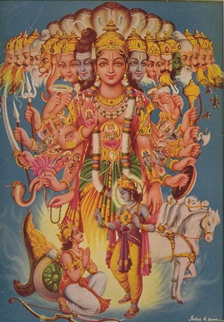
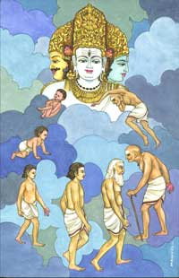
Notes:
10

Slide 11
Lasting Contributions
Writing:
Indus writing has not been fully translated so much of Indus life is still a mystery
Writing contained about 400 symbols that were both pictograms & phonetic characters
Notes:
Unlike cuneiform and hieroglyphics, the writing of the Indus people has not been translated. Historians believe that Indus people used about 400 symbols in their language. Scientists believe the symbols, like hieroglyphs, are used both to depict an object and also as phonetic sounds. Some signs stand alone and others seem to be combined into words.
11

Slide 12
Lasting Contributions
Technology:
Advanced plumbing; Most houses had toilets & private bathrooms connected to underground sewer systems
Standard, oven-baked bricks
Notes:
One of the most impressive technologies of the Indus people was their extensive and modern-looking plumbing systems. Almost every house in Indus cities had a private bathroom and toilet. The toilets were neatly built of brick with a wooden seat. Pipes connected to each house carried wastewater into an underground sewer system. No other civilization had such sophisticated plumbing until the 19th century. In addition, the Indus people built standard, oven-baked brinks, unlike the irregular mud bricks of the Mesopotamians.
12

Slide 13
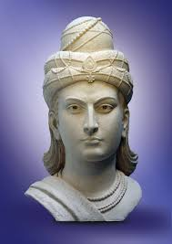
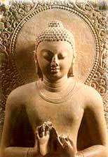
Indian Societies

Slide 14
Harappan or Indus civilization
Description:
developed in the Indus River valley
3000 to 1500 B.C.
Achievements:
planned cities
sewer system

Slide 15
Notes:
Excavations at Mohenjo Daro

Slide 16
Aryans
Description:
nomadic
Indo-European
living in central Asia
1500 B.C. moved south across the Hindu Kush
Notes:
Arian

Slide 18
Aryans
Achievement:
excelled at war
conquered the Harappans
Magadha: the first Aryan kingdom to control almost all of India
Caste System
Notes:
Ma-gah-da

Slide 19
Caste System
Description:
hierarchy of classes
determined a person’s occupation, economic potential, and social status
a way of life as much as a religion
five major classes/castes

Slide 20
Notes:
Brah-min, Sha-tri-a, Vice-see-ya, Su-drahs

Slide 21
Major Caste
Sudras
most of the population
peasants, artisans, manual labor
had limited rights
Untouchables (Pariah/Dalits-lowest class)
not considered part of the caste system
5 percent of the population
had an extremely difficult life
performed tasks that others would not accept
not considered human
other classes considered their presence harmful

Slide 22
Mauryan Empire
Rise:
324 to 183 B.C.
Unified India by Chandragupta Maurya
Overthrew the king of Magaha
Skilled administrator
Developed efficient postal system
Notes:
Mor-e-in

Slide 23
Maurya Empire
Asoka:
269 to 232 B.C.
considered the greatest Indian ruler
converted to Buddhism
governed in accordance with Buddhist ideals

Slide 24
Mauryan Empire (321 - 184 B.C.)
Achievements:
After the adoption of Buddhism, Ashoka:
Never again went to war
Carved his laws on rocks and placed them throughout the kingdom
Established free hospitals
Veterinary clinics
Built roads with rest areas for travelers connected to the Silk Roads

Slide 25
Maurya Empire
Silk Roads:
extensive trade route (about 4,000 miles)
Changan in China to Mesopotamia, then to Antioch, and finally to Greece and Rome
luxury goods from West traded for luxury goods to the East
allowed for cultural diffusion-the spread of the beliefs and social activities of one culture to different ethnicities, religions, or nationalities

Slide 27
Maurya Empire
Fall:
declined after Asoka’s death in 232 B.C.

Slide 28
Gupta Empire
Development:
AD 320 to the end of the fifth century
Built by Chandragupta I
no relation to Chandragupta Maurya
Called the “Golden Age” of India
Time of peace and prosperity
Built many Hindu temples
Reached height under Chandragupta II (A.D. 375 – 415)

Slide 29
Gupta Empire: Achievements
Folktales & Drama:
Panchantantra – folktales to teach moral lessons through stories of animals
Kalidasa, famous playwright – wrote Shakuntala – about the love between a king and forest maiden

Slide 30
Gupta Empire: Achievements
Art and Architecture:
Ajanta Caves
Capital at Pataliputra
Stupas

Slide 31
Notes:
Ajunta caves

Slide 33
Gupta Empire: Achievements
Astronomy:
Realized earth is round
Mathematics:
Developed principles leading to algebra
Invented concepts of infinity and zero
Devised symbols for 1-9 (“Arabic Numerals”)
Developed a decimal system

Slide 34
Gupta Empire: Achievements
Medicine:
Vaccination
Plastic Surgery for facial injuries
Hospital System
Trade:
Arabia (Persia and North Africa) – gems, spices, cotton, teak and ebony
China – silk
Rome – gold

Slide 35
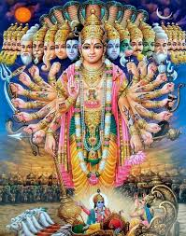
Hinduism
\ \

Slide 36
Hinduism
Founder:
based on Aryan religious beliefs
no single founder, added to over time
Homeland:
India
vast majority of Indian people are Hindus

Slide 37
Hinduism
God:
Brahman = ultimate reality (God)-creator of the world
Hindu gods and goddesses
gave ordinary Hindus a way to express their religious feelings
three chief deities
Brahma the Creator
Vishnu the Preserver
Siva the Destroyer

Slide 38
Hinduism
Sacred Writings:
Vedas = collections of hymns and ceremonies passed down orally by Aryan priests and later written down

Slide 39
Hinduism: Key Beliefs
Henotheistic – recognize existence of many gods but believe in only one supreme god
Atman
the duty of the individual’s true self-beyond ego and “fakeness”
to seek to know this ultimate reality (Brahman)
Fulfilling its duty would allow the soul to merge with Brahman after death

Slide 40
Hinduism: Key Beliefs
Dharma: duties you are expected to perform, the ethical way in which you are supposed to behave
Ahimsa: non-violence towards all living things

Slide 41
Hinduism: Key Beliefs
Reincarnation
the idea that the individual soul is reborn in a different form after death
after many existences, the soul may fulfill its final goal and unite with Brahman
you may be reborn into a higher or lower caste depending on how you lived your previous life

Slide 43
Hinduism: Key Beliefs
Karma
an important part in reincarnation
the idea that people’s actions determine:
their form of rebirth
the class into which they are reborn, if they are reborn as a person

Slide 44
Hinduism: Key Beliefs
caste system
religious basis created by the system of reincarnation
higher caste members worthy of privileges because of good karma
lower classes hoped to improve their social status in future lives if they behaved well in the present

