Slide 1
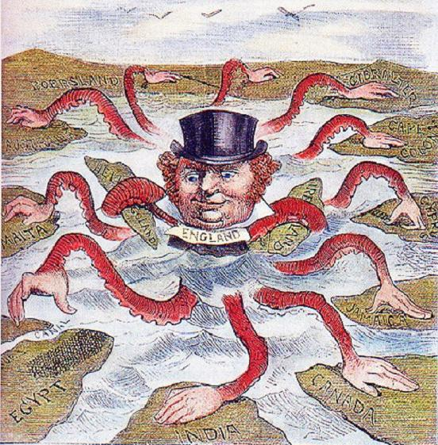
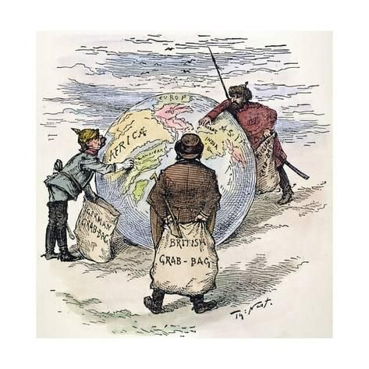
IMPERIALISM

Slide 2
Which of these two passages do you find to be most true?
- “Every empire seeks as its imperialistic mission not to plunder and control but to educate and liberate."
- “The truth is that imperialism was never idealistic. It has always been driven by economic or strategic interests.”

Slide 4
Background of Africa prior to 1800’s
Reasons Europeans had not conquered Africa before:
Strong African armies
Inability to travel into the interior
European susceptibility to diseases
Africa was ethnically and linguistically divided

Slide 5
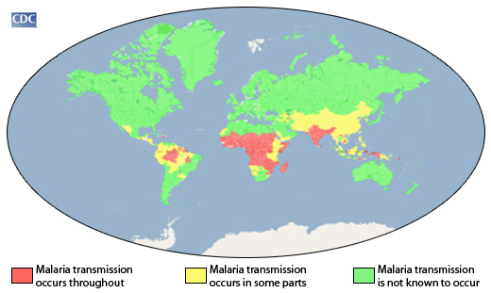

Slide 6
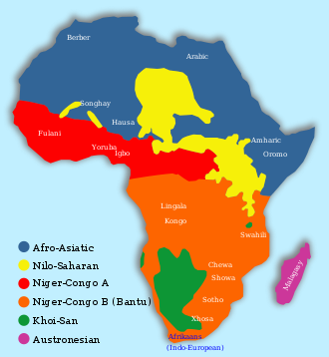
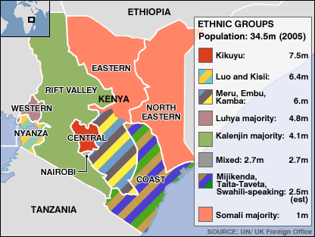

Slide 7
What is imperialism?
Imperialism: policy of extending the rule or authority of an empire or nation over foreign countries, or of acquiring and holding colonies and dependencies

Slide 8
Social Forces Driving Imperialism
Social Darwinism: the ideas of “survival of the fittest” applied to human society.
Those who were more advanced (Europeans) were racially superior to less developed races (Africans and Asians)
Racism: the belief one race is superior to another

Slide 9
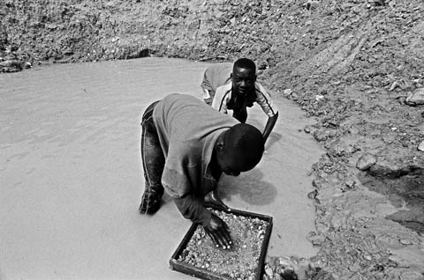
Economic Forces driving Imperialism
Industrialized nations needed more raw materials
African nations were new markets for industrialized goods

Slide 10
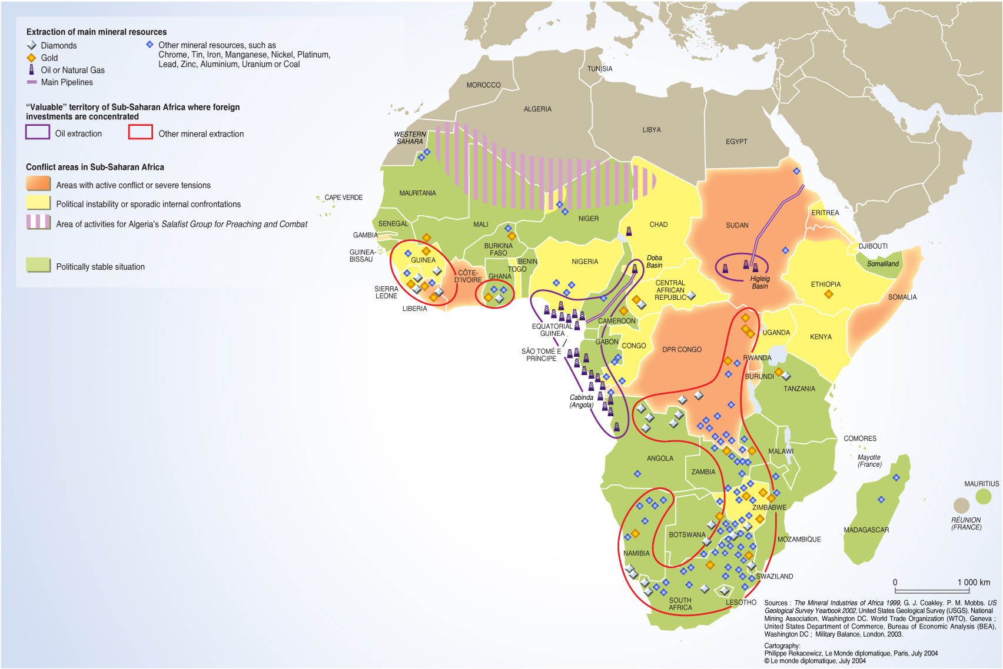

Slide 11
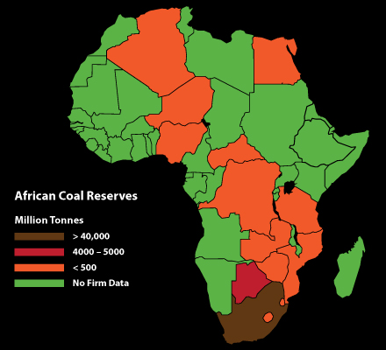

Slide 12
Political Forces behind Imperialism
National pride and the desire to acquire more land for your country to demonstrate power
Competition between nations
Nationalism

Slide 13
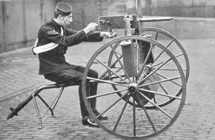
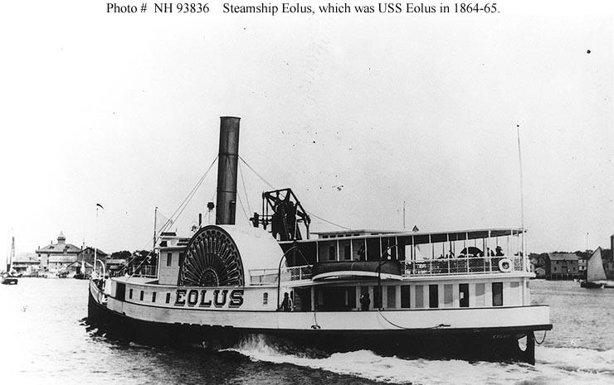
Reasons Europeans were able to Imperialize
More advanced technology
Maxim gun
Steam ship
Railroads
Advancements in medicine
Treatments for Malaria and other tropical diseases
Africa was internally divided
Europeans played nations against each other

Slide 15
Scramble for Africa
Gold, diamonds, tin, copper, rubber and other natural resources were abundant in Africa
Berlin Conference:
1884-1885 conference
Europeans divided African nations
No African leaders present
No regard for ethnic conflicts
Only Ethiopia and Liberia remained free from European rule

Slide 16
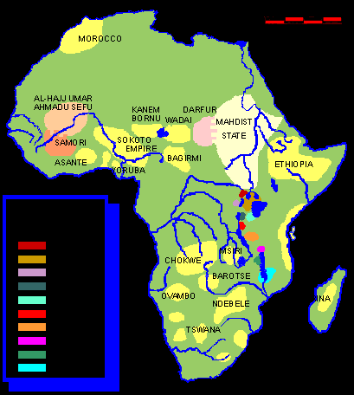
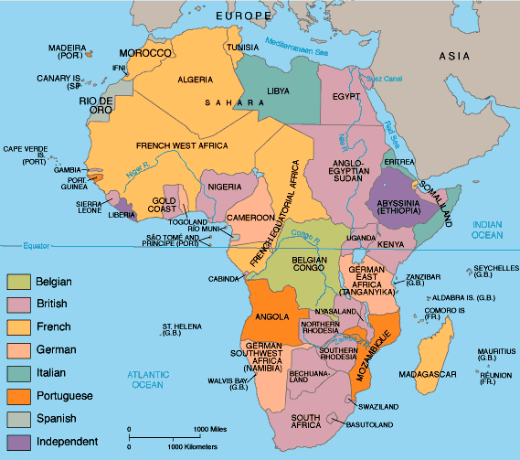
Africa before and after the Berlin Conference

Slide 17
Economic aftermath of Berlin Conference
Africans did not buy European goods
Europeans exploited natural resources
Established plantations
of cash crops

Slide 18
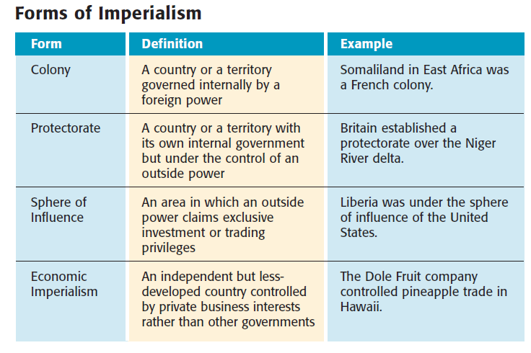

Slide 20
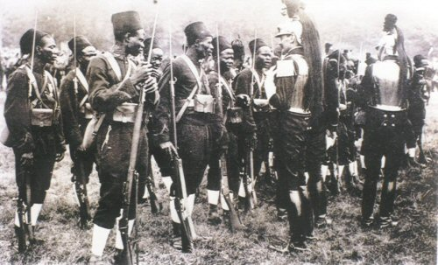
Forms of Control
Direct: foreign officials brought in to govern locals
Developed out of policy of paternalism
Governed in a fatherly way where foreign officials provided for locals’ needs, but did not give them rights
Local officials were not taught how to govern on their own
Assimilated locals in European culture

Slide 21
Forms of Control:
Indirect: relied on existing local political leaders, and gave nations limited self rule
The goal was to develop future native leaders who governed in the style of the imperial nation
Examples: United States and British colonies

Slide 22
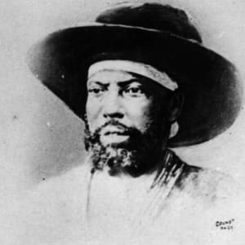
Menelik II
Emperor of Ethiopia
Pitted Italians, French, and Brits against each other (all were trying to control Ethiopia)
Signed treaty with Italy, but felt he was giving up a portion
Defeated Italy in 1896, kept Ethiopia independent

Slide 23
Legacy of Imperialism
Positive Effects:
Reduced local warfare
Infrastructure improved
Health care increased
Economic Expansion

Slide 24
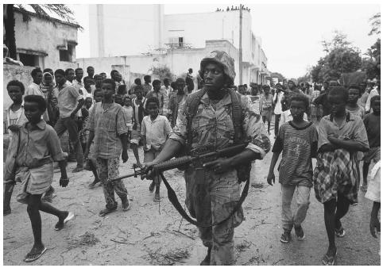
Legacy of Imperialism
Negative Effects:
Africans lost control of land and independence
Disease, resistance, and famines killed thousands
Traditional culture was destroyed
Division of ethnic groups
Joining of rival groups

